Slide 1

Predicting customer buying behaviour
Build a predictive model to understand factors that influence buying behaviour
Created by Tram Nguyen
On 27.08.2023

Slide 2
Task 2
Customers are more empowered than ever because they have access to a wealth of information at their fingertips. This is one of the reasons the buying cycle is very different to what it used to be. Today, if you’re hoping that a customer purchases your flights or holidays as they come into the airport, you’ve already lost! Being reactive in this situation is not ideal; airlines must be proactive in order to acquire customers before they embark on their holiday.
This is possible with the use of data and predictive models. The most important factor with a predictive model is the quality of the data you use to train the machine learning algorithms. For this task, you must manipulate and prepare the provided customer booking data so that you can build a high-quality predictive model.
With predictive model, it is important to interpret the results in order to understand how “predictive” the data really was and whether we can feasibly use it to predict the target outcome (customers buying holidays). Therefore, It is advisable to evaluate the model's performance and output how each variable contributes to the predictive model's power.

Slide 3
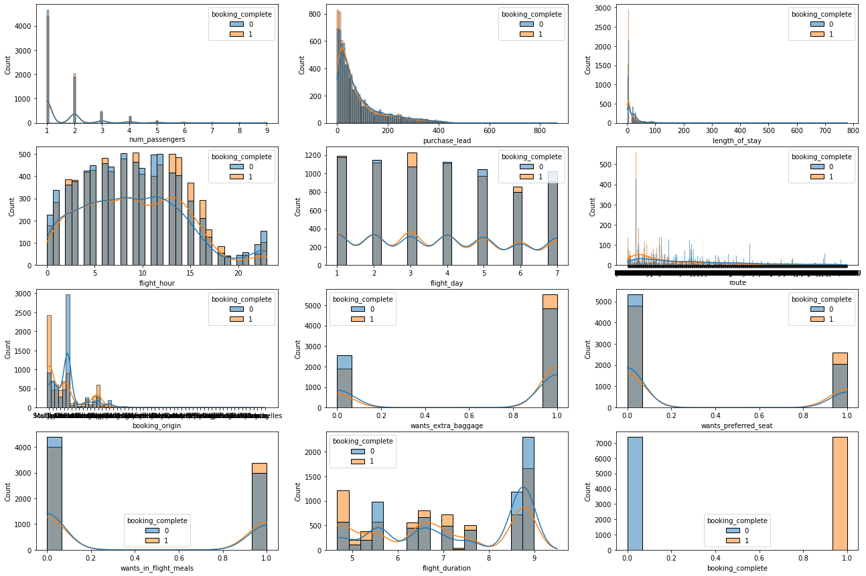
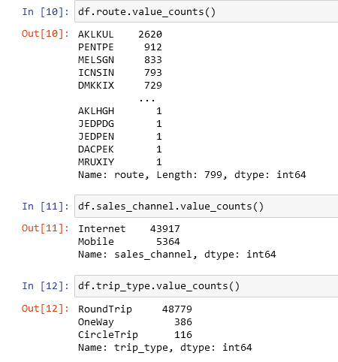
Exploratory data analysis
Summary of dataset:

Slide 4
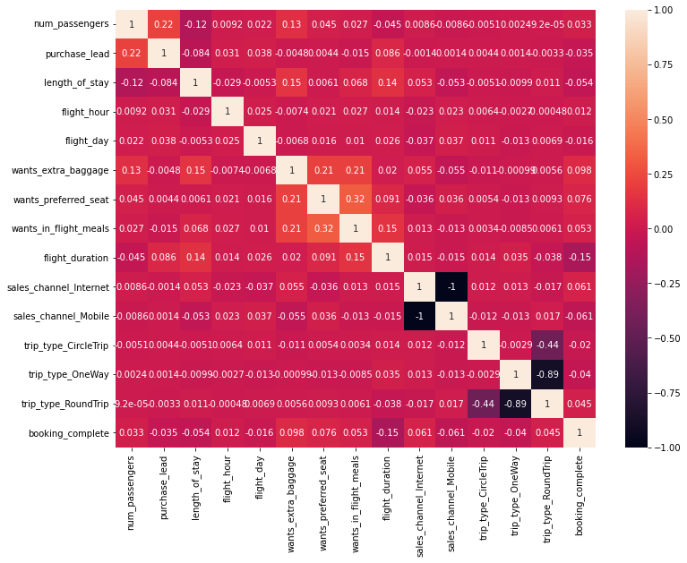
Feature engineering
Examining variable correlation:
According to the result of corr_coeff_exam, the result of most predictive variables are mostly weak or moderate (indication of independent variables)
However, the correlation coefficient between sales_channel_internet and mobile is mutually exclusive and absolutely negative correlated. The similar behaviour is obserbed between trip_type One way and Round Trip. Moreover, each individual sales_channel and trip_type just has very weak or moderate correlation with booking_complete.This indicates that these significantly correlated pairs of individual feature should either be combined back into the original feature or dropped from the model in order to reinforce the model reliability.
Dealing with categorical variables:
use of Chi square test to measure the feature importance and select the best relevant features.
One hot encoding techniques and other categorical encoder to convert categorical variables into numerical ones

Slide 5
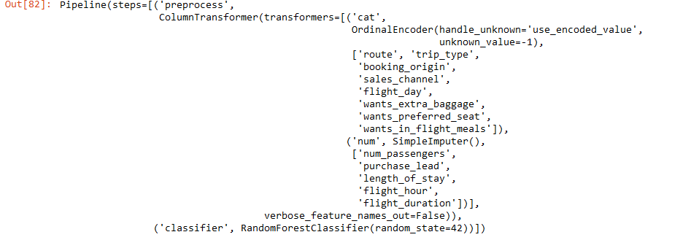
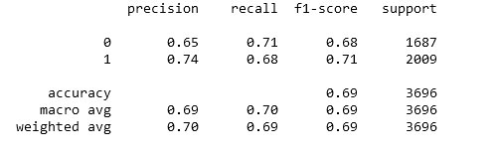
ML predictive model – Random Forest
Train _ test split: 67%-33%
Train dataset : 13 columns, 11086 rows
Test dataset: 13 columns, 3696 rows
Model evaluation

Slide 6
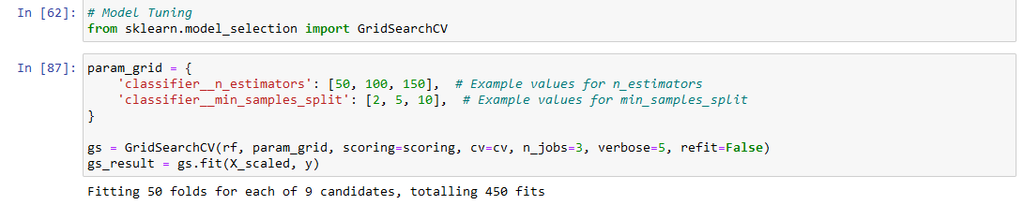
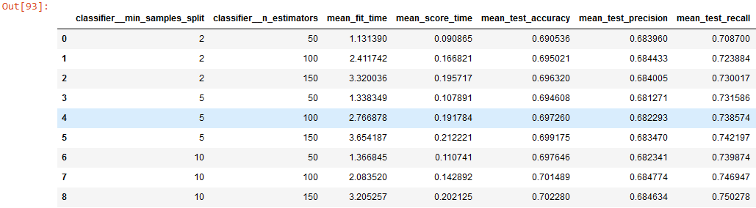
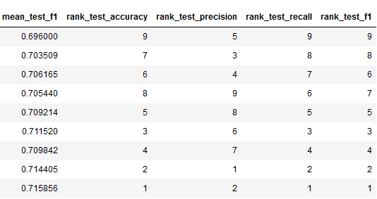
ML predictive model – Random Forest
Model tuning:

Slide 7
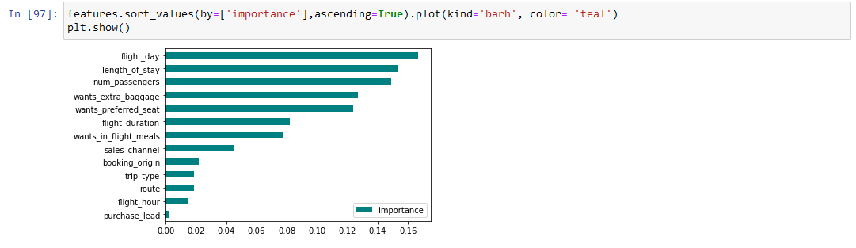
ML predictive model – Random Forest
Based on the above result of gridsearch CV, the combination of 'classifier__min_samples_split' and 'classifier__n_estimators' that yield the best evaluation metrics score on average is (10,300) with the highest ranking of mean scores for test_accuracy, test_precision, test_recall and test_f1 (0.700771 0.682905 0.749730 0.714666 )
Feature importance
After getting the feature importances from rf model which ranges between 0 and 0.16, it is indicated that some features have quite low predictive power. Features with low importance values contribute less additional information to the model when predicting the target variable. They may not provide unique or significant insights into the target variable's behavior. Therefore, in this case feature removal might make sense. After that, it'd be a good tactics to perform feature selection and evaluate its impact on model performance using techniques like cross-validation before deciding to exclude features.

